Slide 1
Arithmetic Expressions
Infix form
operand operator operand
2+3 or
a+b
Need precedence rules
May use parentheses
4*(3+5) or
a*(b+c)

Slide 2
Arithmetic Expressions
Postfix form
Operator appears after the operands
(4+3)*5 : 4 3 + 5 *
4+(3*5) : 4 3 5 * +
No precedence rules or parentheses!
Prefix Form
Operator appears before the operands
(4+3) : +43
Input expression given in postfix form
How to evaluate it?

Slide 3
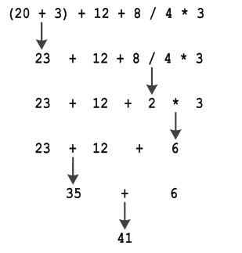

Slide 4
Precedence Rules
Arithmetic operators follow the same precedence rules as in mathematics, and these are: exponentiation is performed first (when available), multiplication and division are performed next, addition and subtraction are performed last.

Slide 5
Infix to postfix
Steps:
1. Scan the infix expression from left to right.
2. If the scanned character is an operand, put it into postfix expression.
3. Else,
…..3.1 If the precedence of the scanned operator is greater than the precedence of the operator in the stack(or the stack is empty), push it.
…..3.2 Else, Pop all the operators from the stack which are greater than or equal to in precedence than that of the scanned operator. After doing that Push the scanned operator to the stack. (If you encounter parenthesis while popping then stop there and push the scanned operator in the stack.)
4. If the scanned character is an ‘(‘, push it to the stack.
5. If the scanned character is an ‘)’, pop and output from the stack until an ‘(‘ is
encountered.
6. Repeat steps 2-6 until infix expression is scanned.
7. Pop and output from the stack until it is not empty.

Slide 6
3+4*5/6
Postfix 3

Slide 7
Infix to prefix
Expression = (A+B^C)*D+E^5 Step 1: Reverse the infix expression. 5^E+D*)C^B+A( Step 2: Make Every '(' as ')' and every ')' as '(' 5^E+D*(C^B+A)
Step 3: Convert expression to postfix form.(While evaluating the operators with same precedence need not be popped out of the stack )
5E^DCB^A+*+
Step 4:Reverse the expression.

Slide 8
Postfix to Infix
Algorithm
While there are input symbol left
Read the next symbol from the input.
If the symbol is an operand
Push it onto the stack
Otherwise,
If the symbol is an operator.
Pop the 2 top values from the stack.(top1=op1,top2=op2, op2 opr op1)
Put the operator, with the values as arguments and form a string.
Push the resulted string back to stack.
If there is only one value in the stack
That value in the stack is the desired infix string.

Slide 9
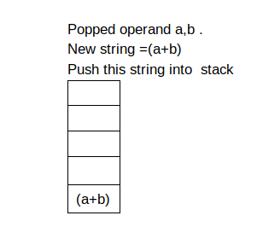
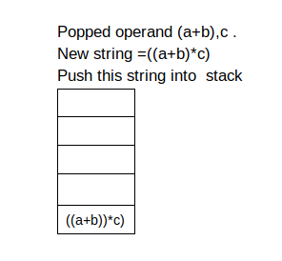
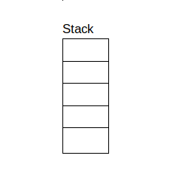
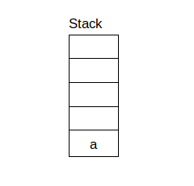
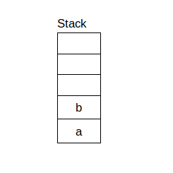
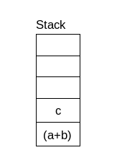
Input postfix expression is ab+c*
Initial empty stack

Slide 10
Prefix to Infix
Read the Prefix expression in reverse order (from right to left)
If the symbol is an operand, then push it onto the Stack
If the symbol is an operator, then pop two operands from the Stack Create a string by concatenating the two operands and the operator between them. string = (top1(op1)+ operator + top2(op2)) And push the resultant string back to Stack
Repeat the above steps until end of Prefix expression.

Slide 11
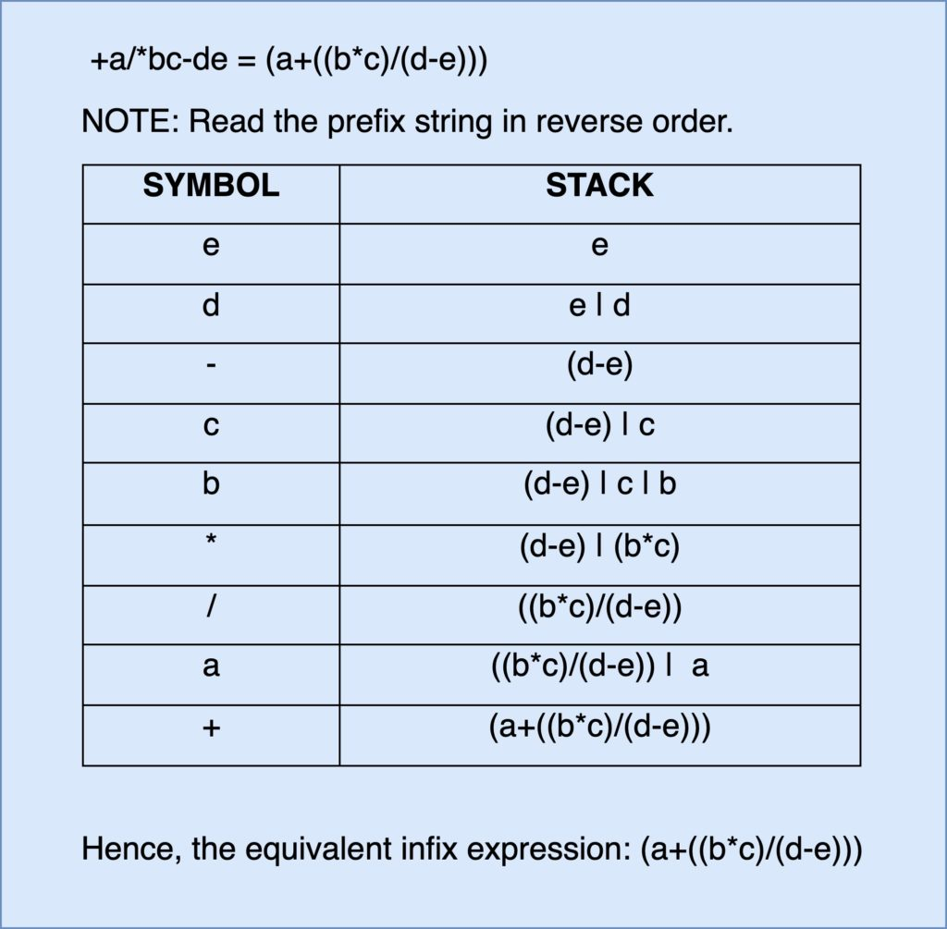

Slide 12
Postfix to Prefix
Postfix – Infix -Prefix

Slide 13
Prefix to Postfix
Prefix – Infix - postfix

Slide 14
Evaluating Postfix Expressions
Use a stack, assume binary operators +,*
Input: postfix expression
Scan the input
If operand,
push to stack
If operator
pop the stack twice
apply operator
push result back to stack

Slide 15
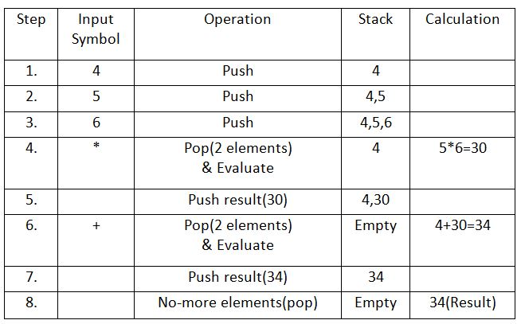

Slide 16
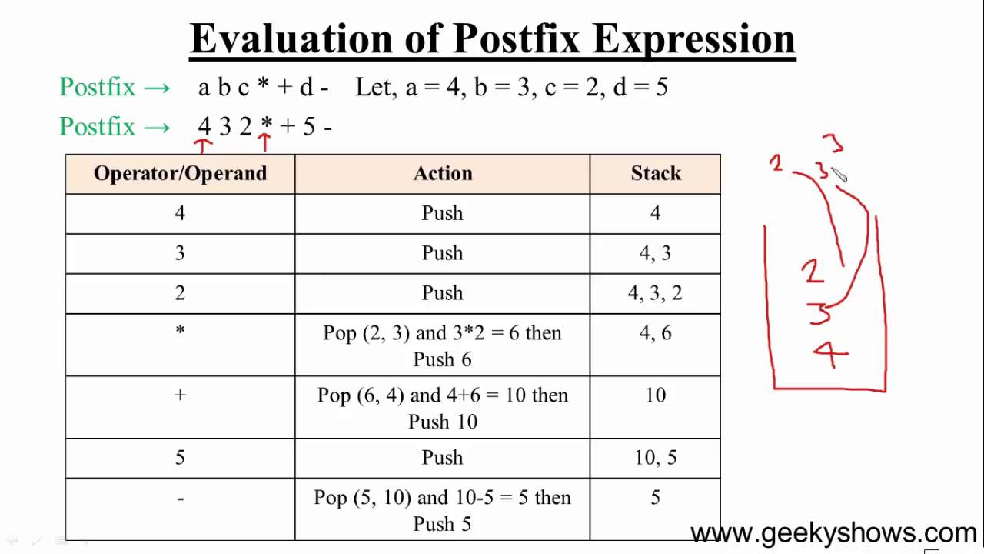

Slide 17
Example
Input
5 9 8 + 4 6 * * 7 + *
Evaluation
push(5)
push(9)
push(8)
push(pop() + pop()) /* be careful for ‘-’ */
push(4)
push(6)
push(pop() * pop())
push(7)
push(pop() + pop())
push(pop() * pop())
print(pop())
What is the answer?

Slide 18
Exercise
Input
6 5 2 3 + 8 * + 3 + *
Input
a b c * + d e * f + g * +
For each of the previous inputs
Find the infix expression

Slide 19
6 5 2 3 + 8 * + 3 + * Ans 288 Verify it.

